Slide 1

Netflix User Behaviour Dataset Analysis Using Py Spark
Name: M. Akshaya
Roll No: 2211CS010649 (S1)
Dataset: Netflix User Behaviour Dataset (Kaggle)
Email: makshaya2704@gmail.com
Linked In: www.linkedin.com/in/meka-akshaya

Slide 2

Introduction
Netflix generates massive amounts of user data every second from viewing history, searches, ratings, and interactions. By applying Big Data Analytics, this data is collected, processed, and analyzed to understand user behavior, improve personalized recommendations, enhance user experience, and strengthen retention strategies.

Slide 3
Initial Analysis of the Dataset
Dataset Size: 10,300 users, 14 main columns including demographics, subscription details, and activity information.
Key Columns: Age, Gender, Country, Subscription Plan, Monthly Spend, Device, Household Size.
Missing Values: Some missing entries in age, monthly_spend, and gender columns.
Duplicates: A few duplicate user entries were found in name/email.
Outliers: Detected in age (very young/very old users) and monthly_spend (extremely high spends).

Slide 4
Initial Analysis of the Dataset
Basic Statistics:
Average age: ~32 years
Average monthly spend: ~$27
Household size mostly 1–4 members
Categorical Distributions:
Gender: Mostly Male and Female
Subscription Plan: Standard > Premium+ > Basic
Devices: Laptop and Mobile dominate
Geography: Highest concentration of users in USA, followed by UK, India, and Canada.

Slide 5
Dataset Observations
Total records: 10,300 users.
Majority of users are aged 20–40 years.
Household size mostly ranges from 1 to 4 members.
Gender distribution is roughly equal between male and female, with very few “Other” or “Prefer not to say.”
Top countries: USA, Canada, UK, India.
Most popular subscription plan: Standard, followed by Premium+ and Basic.
Monthly spend increases with higher-tier plans.
Primary devices: Laptop and Mobile dominate; Smart TV common in family households.
Majority of users are active, with fewer inactive accounts in lower-tier plans.
Dataset is large, diverse, and suitable for behavior analysis and trend insights.

Slide 6
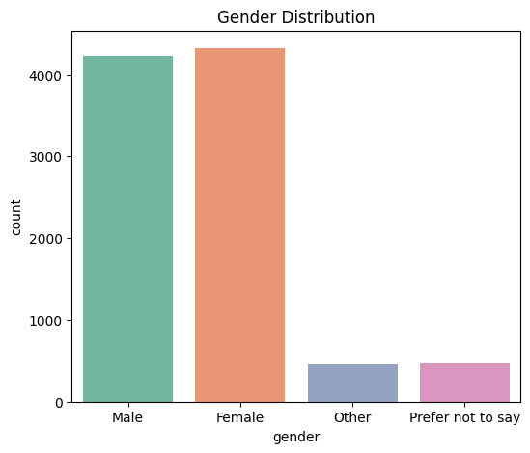
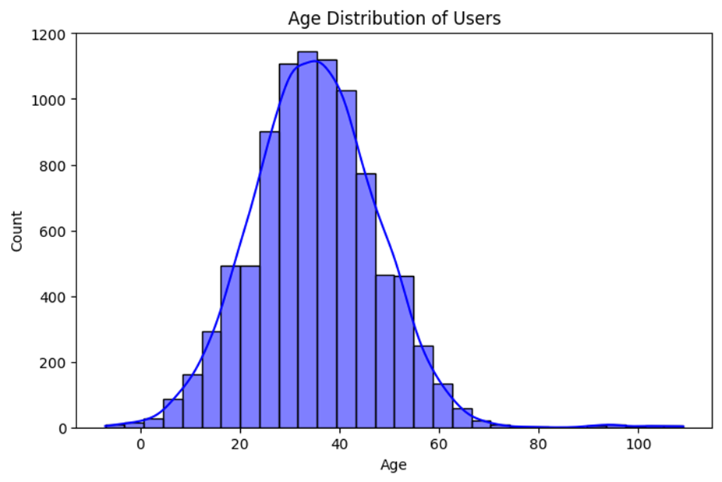
Graphs
1. Age Distribution (Histogram with Curve)
Most Netflix users are aged 20–40 years.
Younger adults dominate the platform.
Few users above 60, indicating limited senior adoption.
2. Gender Distribution (Bar Chart)
Majority of users are Male and Female.
Very few users select Other or Prefer not to say.
Gender balance is roughly equal between male and female.

Slide 7
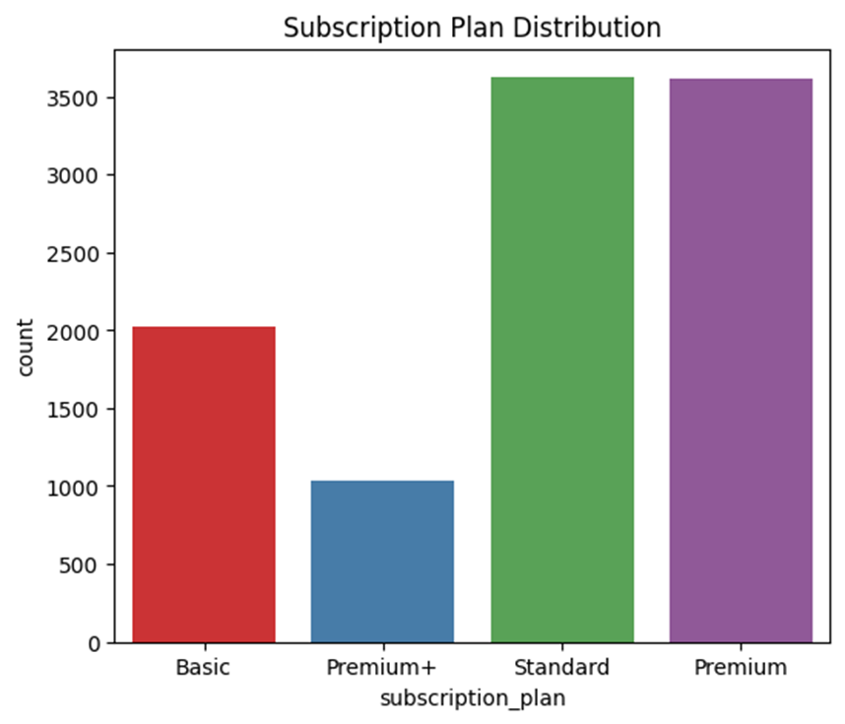
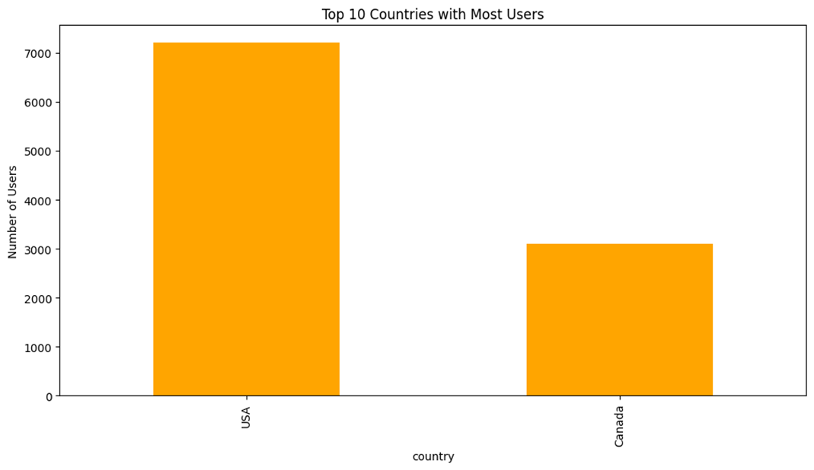
Graphs
3. Top 10 Countries with Most Users (Bar Chart)
USA and Canada have the largest user base.
4. Subscription Plan Distribution (Bar Chart)
Standard and Premium plan are the most popular.
Basic Plan follow next.
Premium+ plan has the fewest users.

Slide 8
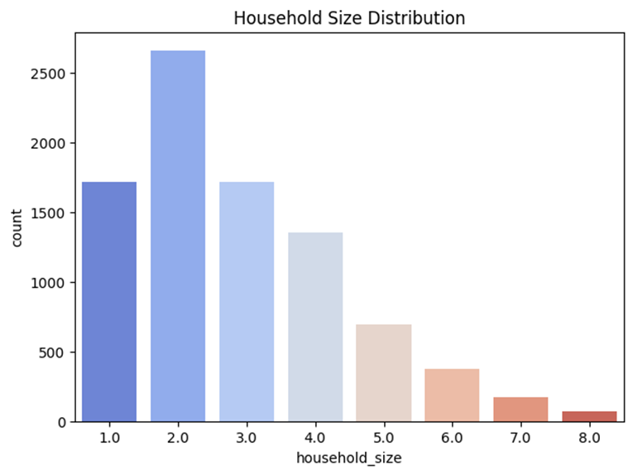
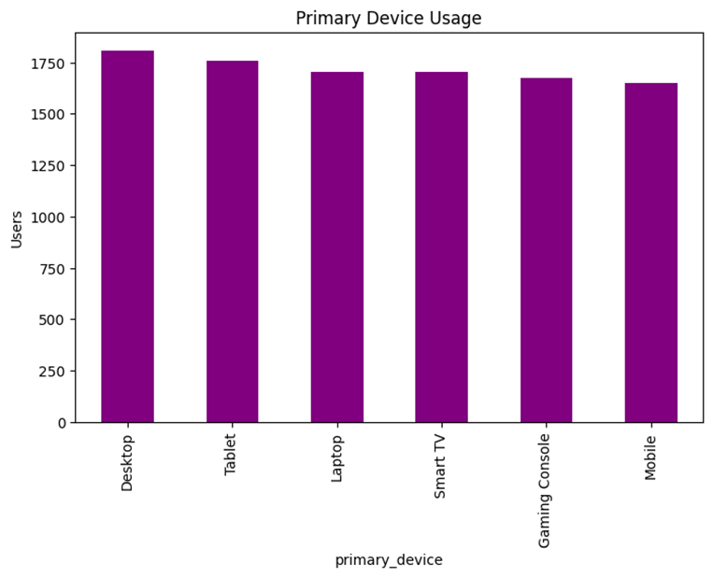
Graphs
5. Primary Device Usage (Bar Chart)
Laptop and Mobile are the most used devices.
Smart TV usage is significant in family households.
Desktop, Tablet, and Gaming Consoles are least common.
6. Household Size Distribution (Bar Chart)
Most users belong to households of 1–4 members.
Larger households (>4 members) are less common.
Household size correlates with subscription plan type.

Slide 9
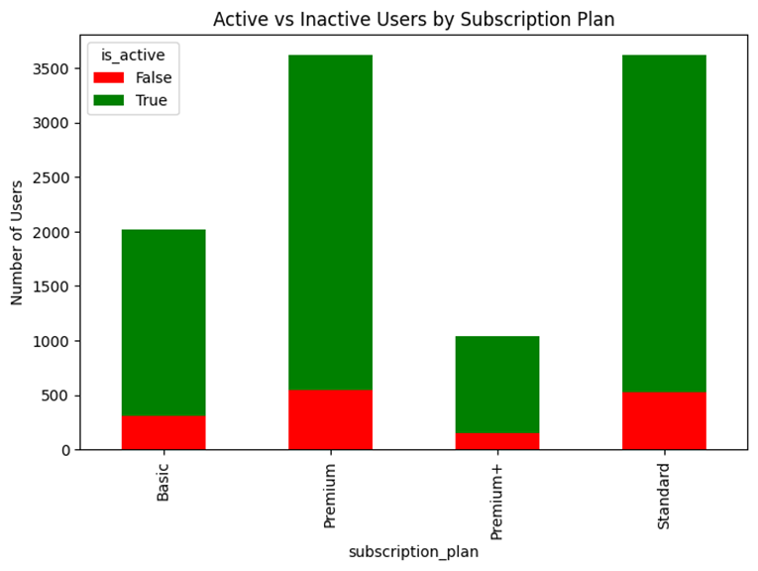
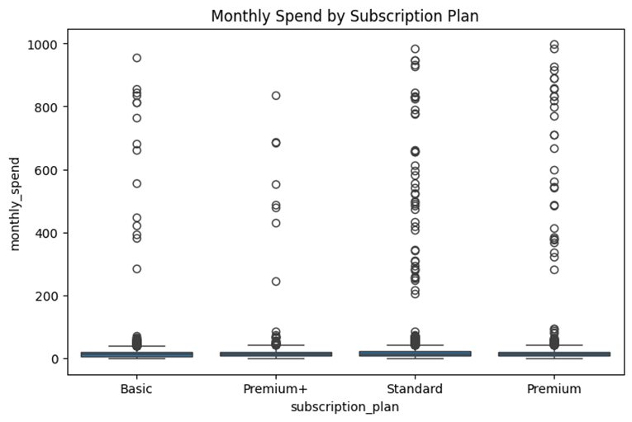
Graphs
7. Monthly Spend by Subscription Plan (Scatter Plot)
Standard users spend the most monthly.
Premium and Basic plan users have moderate spending.
8. Active vs Inactive Users by Subscription Plan (Bar Chart)
Majority of users are active (green) across all plans.
Inactive users (red) are fewer, mostly in Premium and Standard plans.
Premium and standard plans have highest active retention.

Slide 10
Conclusion
Netflix is primarily used by young adults aged 20–40, with most households having one to four members. The Standard plan is the most popular, and higher-tier plans correspond to higher monthly spending. Laptops and mobiles are the main devices, while Smart TVs are common in family households. Most users are active, and the majority are from the USA, Canada, UK, and India. These insights can guide marketing, content recommendations, and retention strategies.

